Slide 1
Regression Mediation
Chapter 10

Slide 2
Mediation
Refers to a situation when the relationship between a predictor variable and outcome variable can be explained by their relationship to a third variable (the mediator).

Slide 3
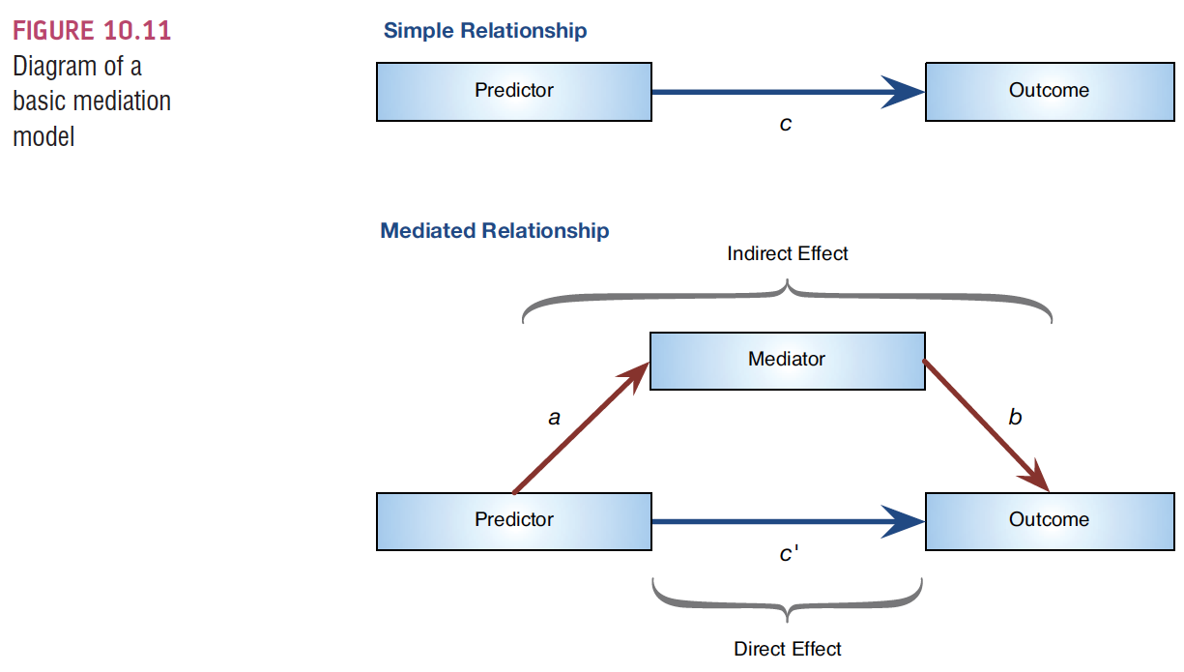
The Statistical Model

Slide 4
Baron & Kenny, (1986)
Mediation is tested through three regression models:
Predicting the outcome from the predictor variable.
Predicting the mediator from the predictor variable.
Predicting the outcome from both the predictor variable and the mediator.
This procedure has been cited over 35,000 times.

Slide 5
Baron & Kenny, (1986)
Four conditions of mediation:
The predictor must significantly predict the outcome variable.
The predictor must significantly predict the mediator.
The mediator must significantly predict the outcome variable.
The predictor variable must predict the outcome variable less strongly in model 3 than in model 1.

Slide 6
Limitations of Baron & Kenny’s (1986) Approach
How much of a reduction in the relationship between the predictor and outcome is necessary to infer mediation?
people tend to look for a change in significance, which can lead to the ‘all or nothing’ thinking that p-values encourage.

Slide 7
Sobel Test (Sobel, 1982)
An alternative is to estimate the indirect effect and its significance using the Sobel test (Sobel. 1982).
If the Sobel test is significant, there is significant mediation

Slide 8
Sobel Test online
http://quantpsy.org/sobel/sobel.htm

Slide 9
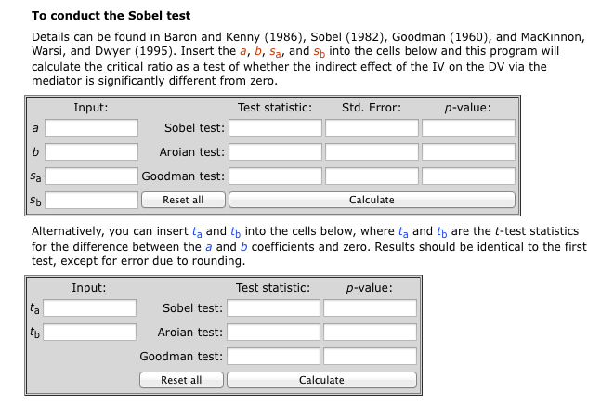

Slide 10



Effect Sizes of Mediation

Slide 11



Effect Sizes of Mediation II

Slide 12

Effect Sizes of Mediation III Kappa-squared (k²) (Preacher & Kelley, 2011)
Interpretation is same a R² effect sizes.

Slide 13
Example of a Mediation Model
Does facebook mediate the relationship between previous knowledge and exam scores?

Slide 14
Install PROCESS
http://afhayes.com/introduction-to-mediation-moderation-and-conditional-process-analysis.html

Slide 15
Install Process
Download process file.
Follow PDF to install the file.

Slide 16
Mediation
Data screening:
Screen both the IV and the Mediator at the same time predicting the DV … you will have to do those steps before you run PROCESS.
The steps are the same as regular regression.

Slide 17
Mediation
Analyze > regression > process.

Slide 18
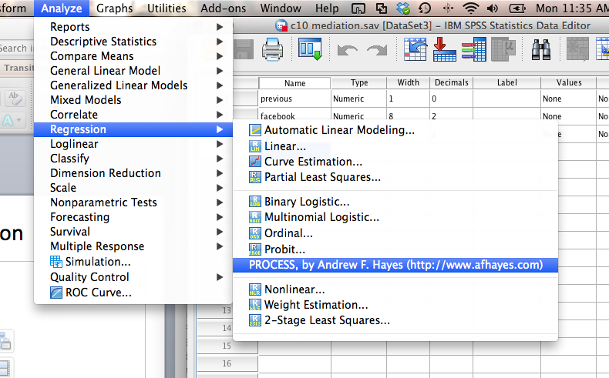
Mediation

Slide 19
Mediation
This window is a custom dialog box. (it’s great!).
For mediation you leave the model number as 4 (there are 75 types, typical mediation is 4).

Slide 20
Mediation
Leave boot strap and confidence intervals alone, unless you want 99% CI.
Under outcome variable, put in the Y variable (DV).

Slide 21
Mediation
Put the IV (X) in to the independent variable.
Put the mediator (M) in the the M variables box.

Slide 22
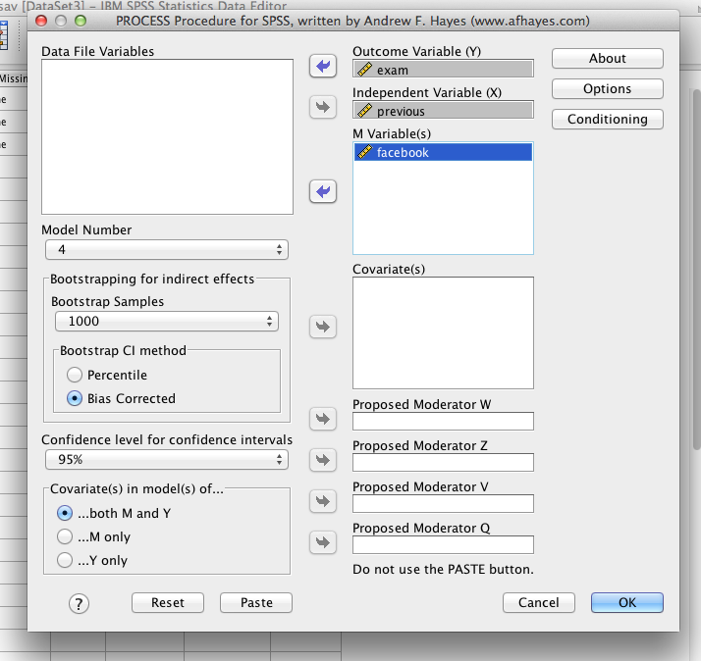
Mediation

Slide 23
Mediation
Hit options.
For mediation, you want:
Effect sizes
Sobel test
Total effect models
Compare indirect effects

Slide 24
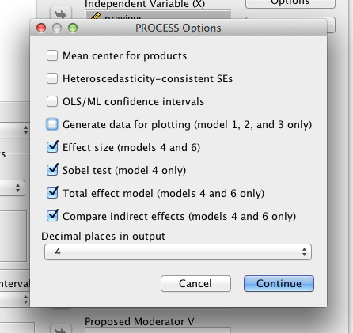
Mediation

Slide 25
Mediation
Hit ok!

Slide 26
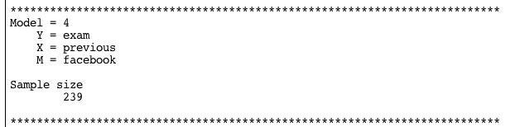
Mediation
Tells you what your variables where (check!)

Slide 27
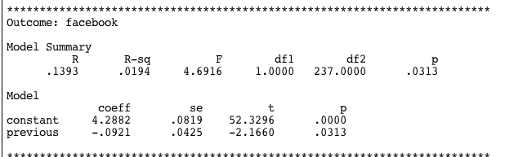
Mediation
Path a

Slide 28
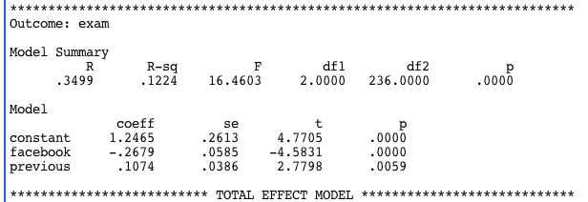
Mediation
Path b and c’

Slide 29
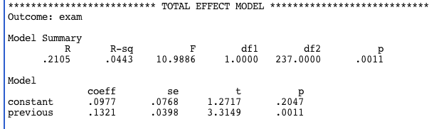
Mediation
Path c

Slide 30
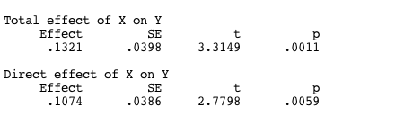
Mediation
Path c and c’ repeated

Slide 31

Mediation
The mediation effect:

Slide 32
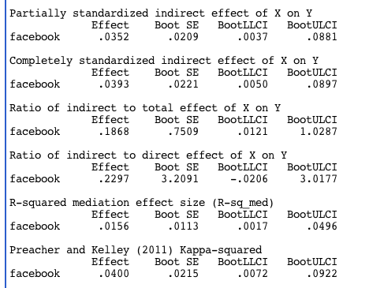
Mediation
Partial
Standardized
Pm
Rm
R²m
kappa²

Slide 33

Mediation
Sobel test

Slide 34
Mediation
How to report:
Usually make a table of a, b, c, c’ F values
A diagram of a, b, c, c’ unstandardized b values

Slide 35
Mediation Example
Age – age of women completing questionnaire
Gossip – rating of tendency to gossip average
Mate_value – rating of mate value average
C10 mediation 2.sav

Slide 36
Mediation Example
As women age, gossip decreases because of less competition for partners, but this value
will be mediated by the attractiveness of the person
Example from page 418

Slide 37
Mediation Example
Run the mediation!
Analyze > regression > Process.
Move over the right variables into X, M, Y.
Make sure model is 4.
Click options
Effect size, Sobel, Total Effects, Indirect Effects

Slide 38
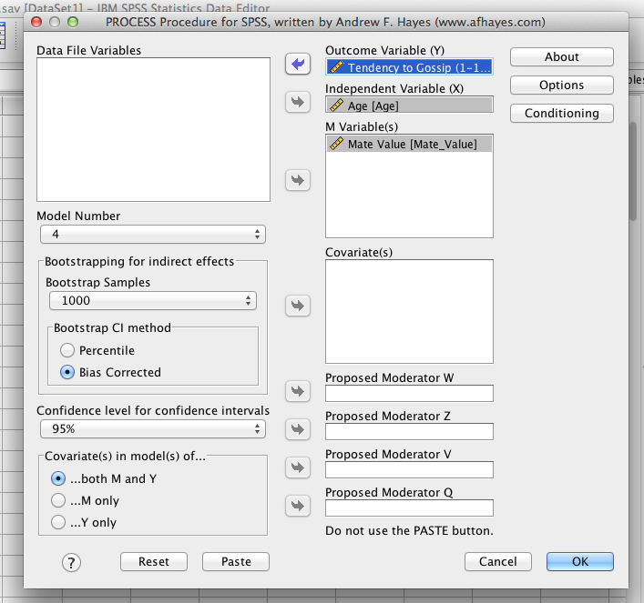

Slide 39
See Handout!

Slide 40
Moderation
The combined effect of two variables on another is known conceptually as moderation, and in statistical terms as an interaction effect.

Slide 41
Example
Do violent video games make people antisocial?
Participants
442 youths
Outcome
Aggression,
Callous unemotional traits (CaUnTs)
Number of hours spent playing video games per week

Slide 42
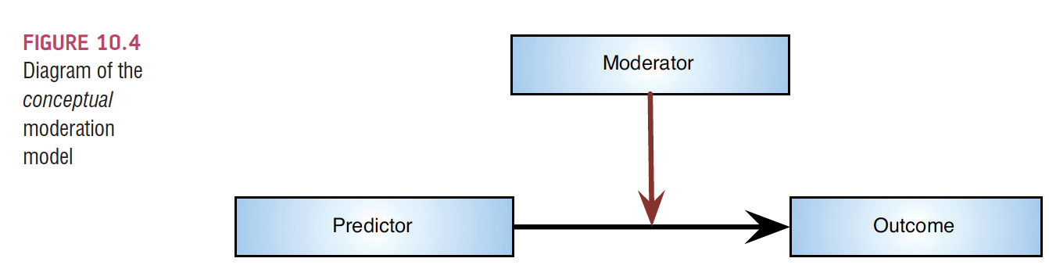
Conceptual moderation model
If callous-unemotional traits were a moderator then we’re saying that the strength or direction of the relationship between game playing and aggression is affected by callous-unemotional traits.

Slide 43
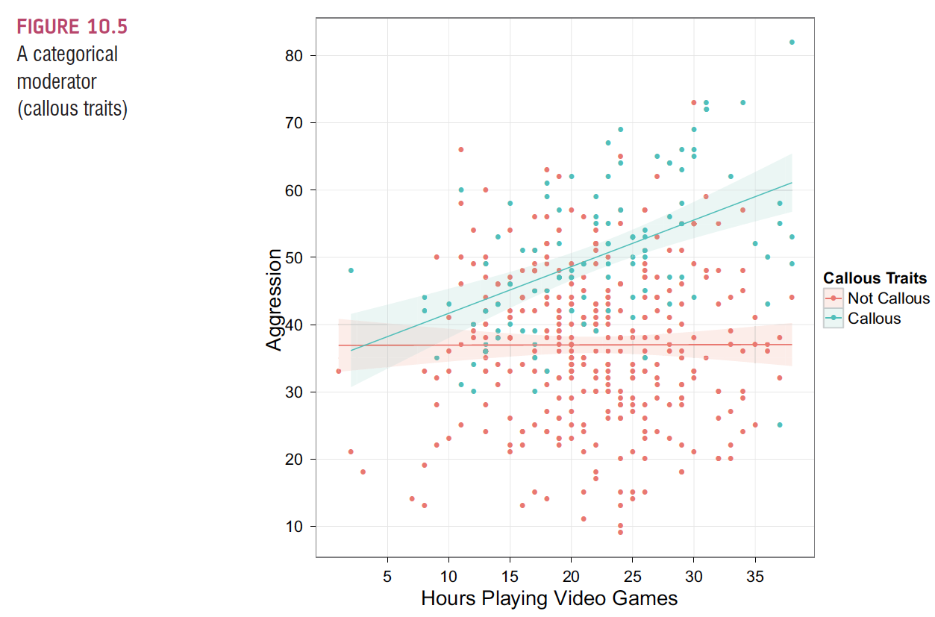

Slide 44
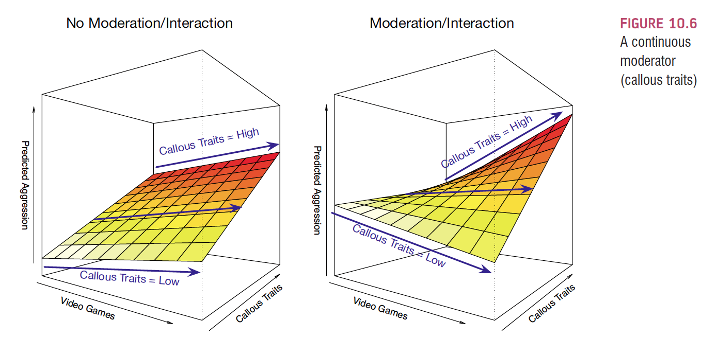

Slide 45
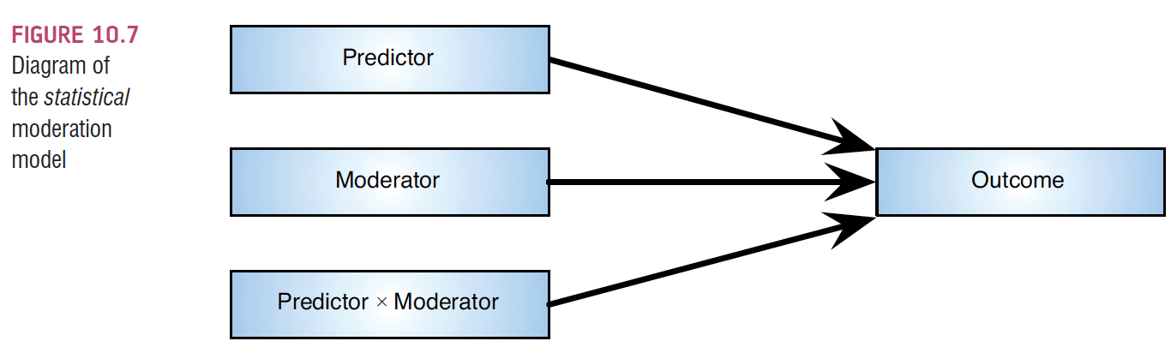
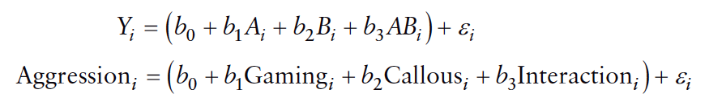
The Statistical Moderation Model

Slide 46
Centering variables
The interaction term makes the bs for the main predictors uninterpretable in many situations.
Centering refers to the process of transforming a variable into deviations around a fixed point.

Slide 47
Centering variables
Easiest way to center to make them useful:
Score – Mean for that variable.
What does that do?

Slide 48
Centering variables
Centered variables for main effects have two interpretations
Effect of that predictor at the mean value for the sample
Average effect of the predictor across a range of scores for the other predictor

Slide 49
Centering variables
Centering does not change the higher-order effects (interactions)
Does change the lower-order effects (main effects, each variable alone)

Slide 50
Interactions in regression
Just like ANOVA, if the interaction is significant, then you usually ignore the main effects (each variable by itself)
PROCESS creates the interaction for you
But interactions are just variable 1 X variable 2

Slide 51
Interactions in regression
So what do I do if my interaction is significant?
Called a simple slopes analysis
(remember before it was called simple effects)
If variables are dichotomous, then you are simply looking at the differences across one variable or another (whichever one you stick in the M box)

Slide 52
Interactions in regression
For continuous variables, you “create” low, average, and high groups.
Low groups are people who are one SD below the mean
Average groups are people are at the mean
High groups are people who are one SD above the mean

Slide 53
Interactions in regression
Johnson – Neyman’s zone of significance
Tests the interaction effect at many values
Tells you the “zone” or area of values that have significant slopes
More precise than regular simple slopes (but used less often)

Slide 54
Example
We are examining the interaction between
Hours of playing video games
Callous – unemotional traits
Predicting
Aggression

Slide 55
Example
Think about which variable you want to know the differences in (i.e. low, average, high)
So at different levels of callousness, we want to examine the relationship between hours of video games and aggression

Slide 56
SPSS
Analyze > regression > process
Put the variable you want the levels into M (callous)
Put the other IV into the independents box (hours of video games)
Put the DV into the Y box (aggression).
Change the model number to 1 for moderation

Slide 57
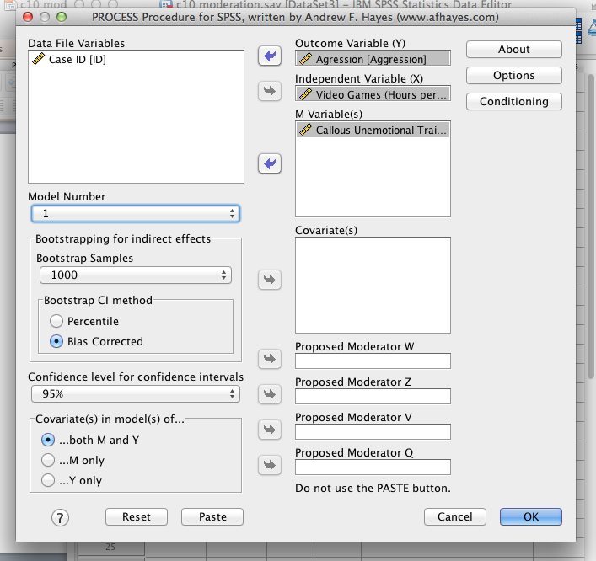

Slide 58
SPSS
Hit options
Pick the first four:
Mean center, heteroscedasticity, OLS/ML CI, generate data

Slide 59
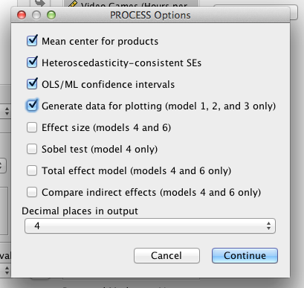

Slide 60
SPSS
Hit conditioning
Select Johnson-Neyman

Slide 61
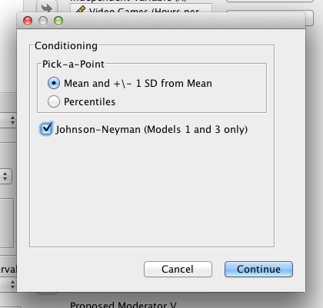

Slide 62
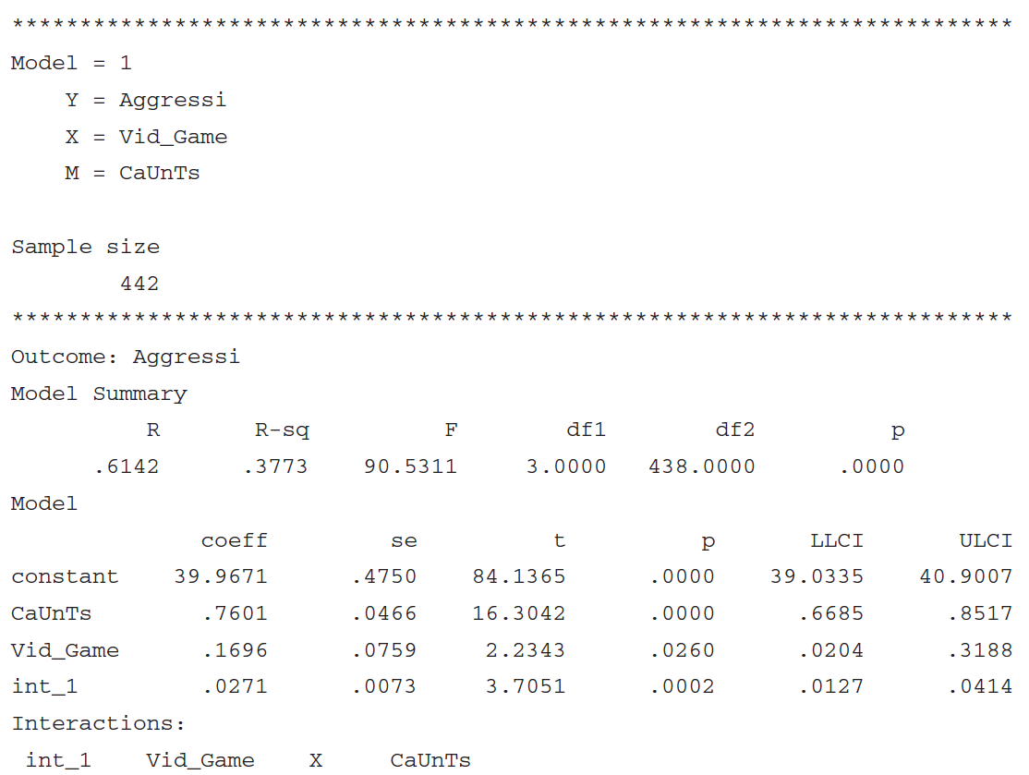
Output from moderation analysis

Slide 63
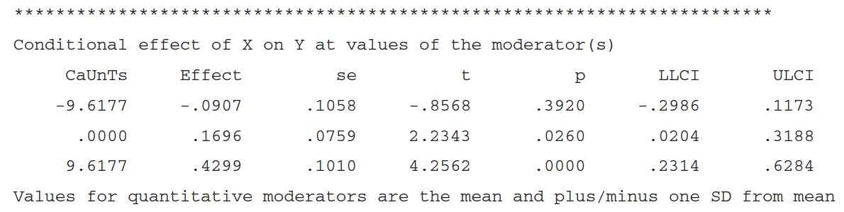
Output from moderation analysis II

Slide 64
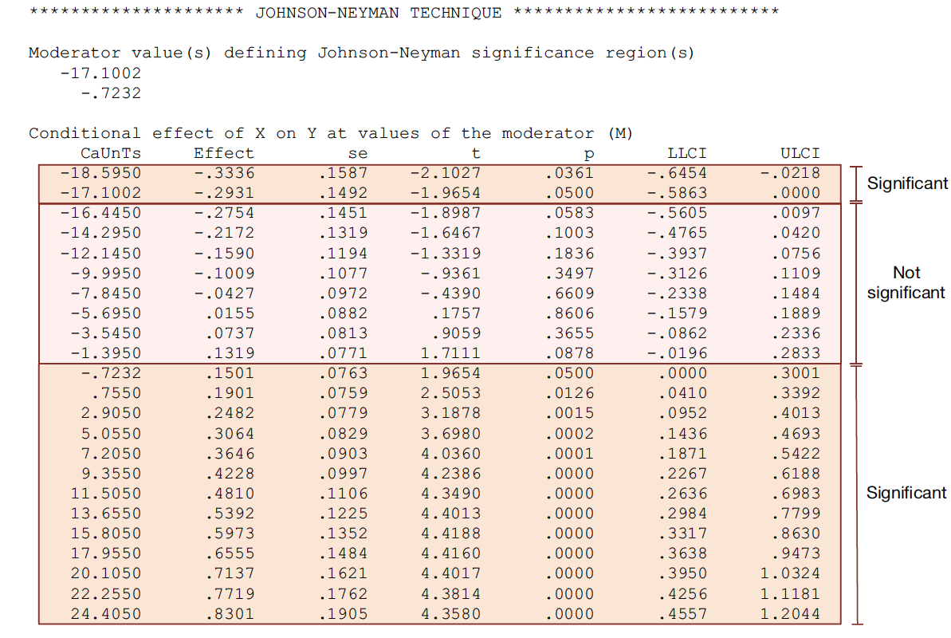
Output from moderation analysis III

Slide 65
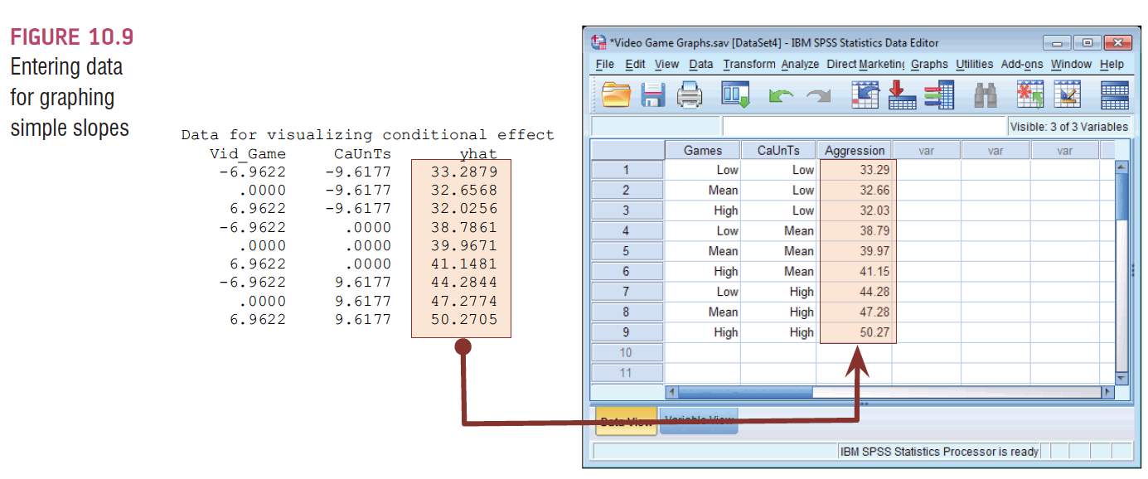
Following up Moderation with Simple Slopes analysis

Slide 66
SPSS
Take data from end of output and put into a new SPSS document.
Just that last column.
Use Low for negative numbers (code as -1)
Average for 0s. (code as 0)
High for positive numbers. (code as 1)

Slide 67
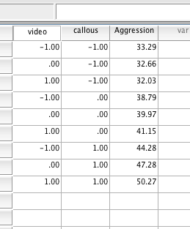
SPSS

Slide 68
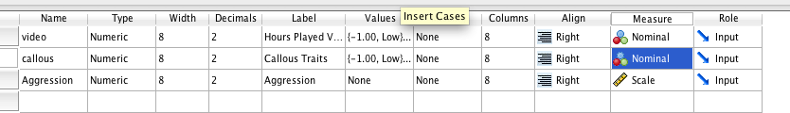
SPSS
Put value labels on the -1, 0, 1 codings to get the output to say those labels rather than the numbers.
Make sure the DV is labeled as a scale variable, but the other two variables need to be coded as nominal

Slide 69
SPSS
Graphs > chart builder
Pick line graphs > multiple line

Slide 70
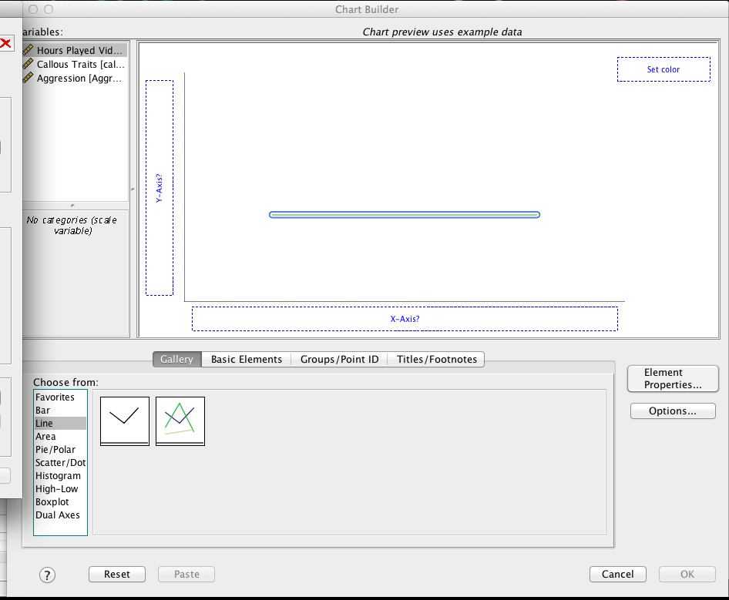

Slide 71
SPSS
Put your DV on the Y-axis
Put one IV into the X-axis
Put the other IV into the “set color” option top right.

Slide 72
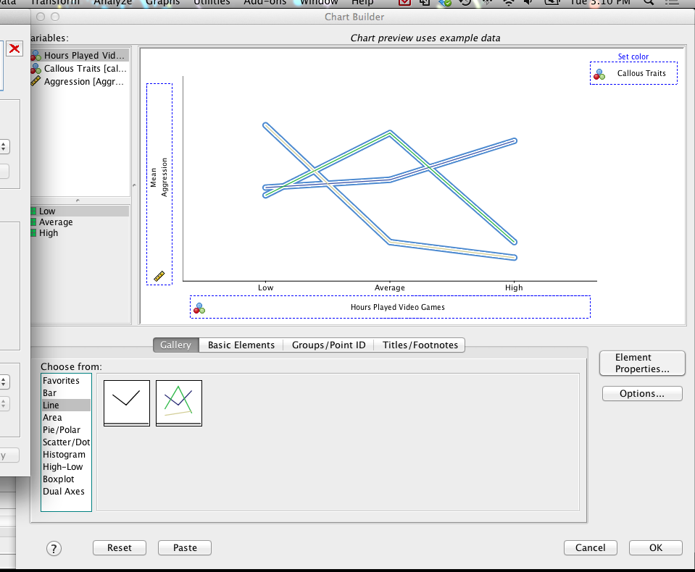

Slide 73
SPSS
You can’t really do error bars here because we have dichotomized the data to make the graph, so they will not work.

Slide 74
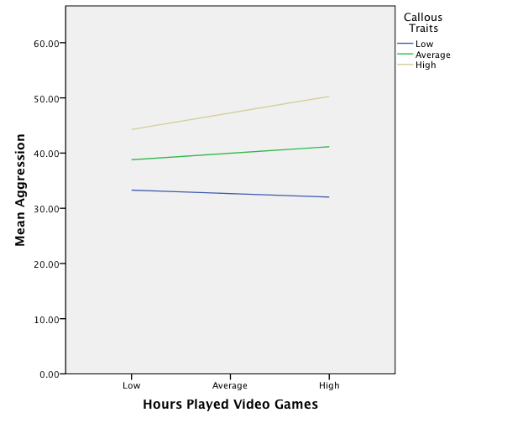

Slide 75
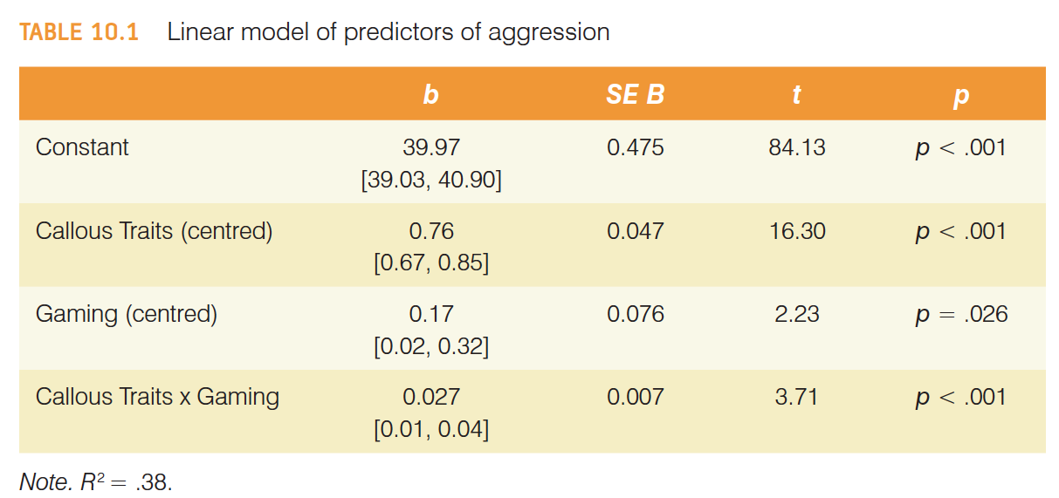
Reporting moderation analysis

